Slide 1
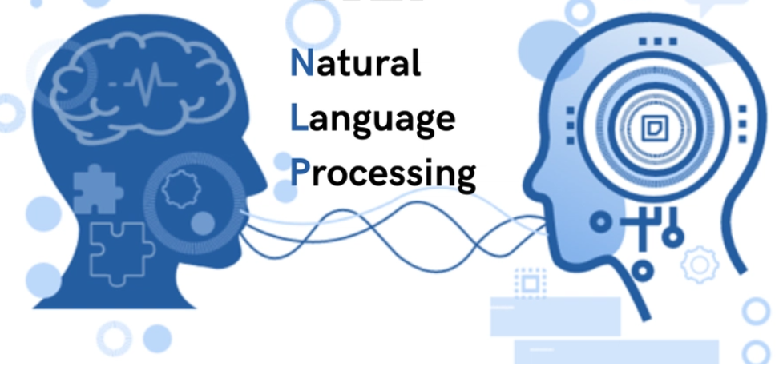
NLP- Natural Language Processing “If you use a smartphone, you are already using NLP every day.”

Slide 2
What is NLP?
Natural Language Processing (NLP) is a branch of Artificial Intelligence that helps computers understand, interpret, and generate human language.
NLP = Computer + Human Language
It teaches computers to understand text and speech the way humans do.

Slide 3
Why NLP is important?
Examples:
When you type in Google: "best restaurants near me" → NLP understands your query.
Alexa/Siri/Google Assistant → NLP processes your voice.
YouTube/Netflix recommendations → understands your preferences.
ChatGPT → built using NLP.
Spell-check in MS Word → NLP identifies mistakes.
WhatsApp autocorrect & prediction → NLP.
Spam detection in Gmail → NLP filters useful mail.

Slide 4
Syllabus:

Slide 5
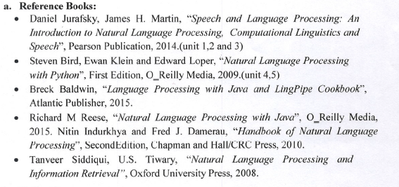

Slide 6
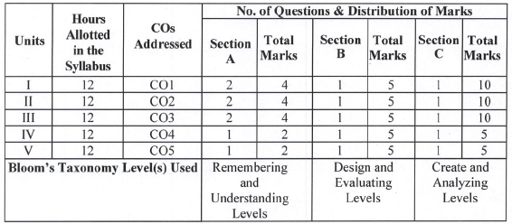

Slide 7
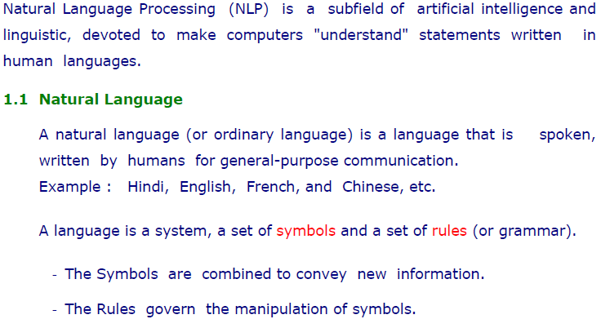

Slide 8
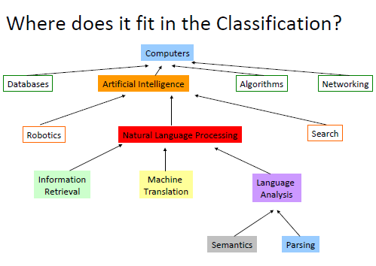

Slide 9
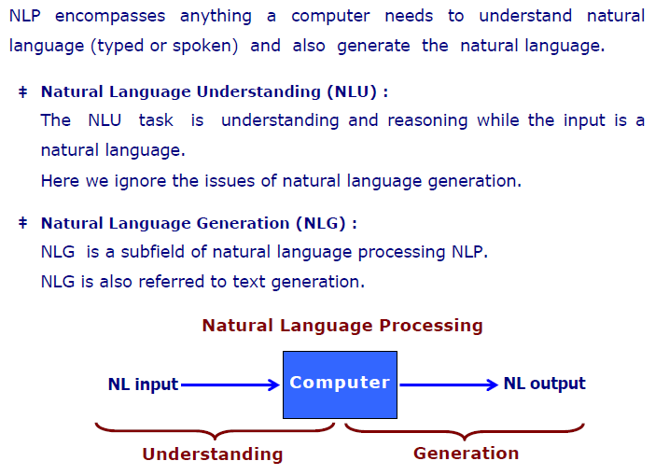
NLP

Slide 10
Natural Language Understanding (NLU)
NLU is how a computer understands what we are saying or writing.
Example: You type: "What's the weather like in New York?"
The computer needs to:
Identify the topic (weather).
Recognize the location (New York).
Understand your intent (you want weather information).
NLU's job: Break your sentence into pieces and understand:
Intent: You want information.
Key Details: "weather" and "New York."

Slide 11
Natural Language Generation (NLG)
NLG is how a computer creates language to respond to us.
Example: After understanding your query, the system gets the weather data for New York and needs to present it to you.
The response might be: "The weather in New York is sunny with a high of 75°F today."
NLG's job:
Pick the correct words.
Form a clear and natural-sounding sentence.

Slide 12
Combined Example (NLU + NLG)
In a chatbot:
You say: "Can you set a reminder for my meeting tomorrow at 10 AM?"
NLU does this:
Understands you want to set a reminder.
Extracts details: "meeting," "tomorrow," and "10 AM."
NLG does this:
Creates a response: "Sure! I’ve set a reminder for your meeting tomorrow at 10 AM."

Slide 13
Natural Language Understanding (NLU):EX.2
Enables computers to understand what humans say or write.
1. Example:
You ask: “Show me Italian restaurants nearby.”
NLU breaks this down:
Intent: Find restaurants.
Type: Italian.
Context: Nearby.
2. Applications:
Chatbots, search engines, voice assistants (like Alexa or Siri).

Slide 14
Natural Language Generation (NLG)
What it Does:
Enables computers to generate human-like text responses.
Example:
After understanding the above query, the system retrieves restaurant data and replies: “Here are three Italian restaurants near you: Luigi’s, Pasta House, and Bella Italia.”
Applications:
Report generation, automated emails, text summaries.

Slide 15
Combined Example (NLU + NLG)
Scenario: You say: “Remind me about the doctor’s appointment tomorrow at 10 AM.”
NLU:
Understands you want to set a reminder.
Extracts:
Event: “doctor’s appointment.”
Time: “10 AM.”
Date: “tomorrow.”
NLG:
Responds: “Got it! I’ve set a reminder for your doctor’s appointment tomorrow at 10 AM.”
Real-Life Example:
Virtual assistants like Google Assistant or Alexa combining NLU and NLG to respond effectively

Slide 16
History
Year | Milestone | Description
1950 | Turing Test introduced. | Alan Turing introduced the Turing Test to evaluate a machine's ability to exhibit human-like intelligence through language.
1954 | Georgetown-IBM Machine Translation experiment. | Example: The Georgetown-IBM Experiment (1954) translated 60 Russian sentences into English using a rule-based system
1966 | ELIZA chatbot developed. | Joseph Weizenbaum developed ELIZA, an early chatbot that simulated a psychotherapist by responding to user input. Example:User: "I feel sad." ELIZA: "Why do you feel sad?“
1970 | SHRDLU demonstrates semantic understanding. | Developed by Terry Winograd, SHRDLU understood and responded to commands in a simplified "blocks world. "Example: "Move the red block onto the blue block."

Slide 17
History
Year | Milestone | Description
1997 | Dragon Dictate introduces speech recognition. | Systems like Dragon Dictate (1997) enabled speech-to-text conversion.
2006 | Google Translate launches using statistical methods. | Example: Google Translate (2006) began using statistical techniques for language translation.
2017 | Transformers revolutionize NLP. | Applications Boom: Chatbots, virtual assistants, machine translation, and content generation became mainstream.
2018 | BERT and GPT set new standards in language processing. | Models like BERT (2018), GPT (2018), and T5 made understanding and generating human-like text possible.

Slide 18
History
Year | Milestone | Description
2020 | NLP in the age of AI | Large Language Models (LLMs): Models like GPT-4 and ChatGPT demonstrated the ability to perform complex tasks like summarization, question answering, and creative writing. Multimodal NLP: Integration of text, image, and speech processing. Example: AI systems that understand captions or respond to visual cues.

Slide 19
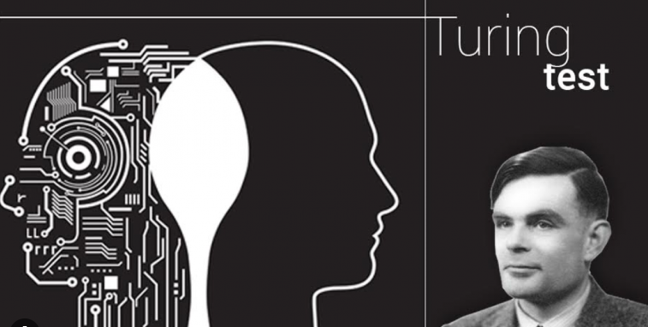
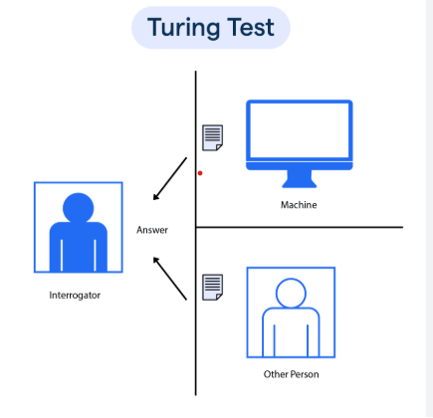
What is Turing Test?
The Turing Test, proposed by Alan Turing in 1950, is a method used to determine a machine's ability to exhibit intelligent behavior equivalent to, or indistinguishable from, human behavior.
In this test, a human evaluator communicates with a machine and another human.
If the evaluator cannot reliably determine which participant is the machine, then the machine is said to have passed the test, showcasing "human-like" intelligence

Slide 20
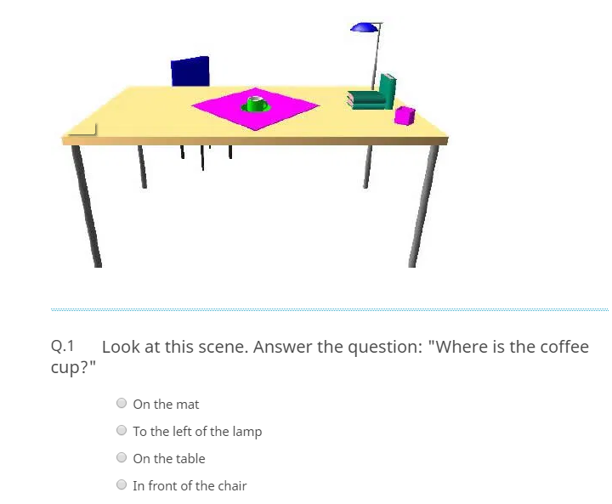
Acts Like Human – Turing Test

Slide 21
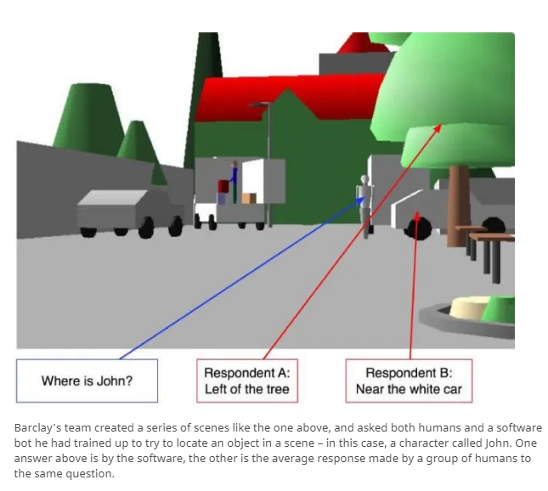
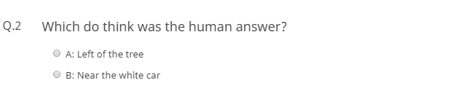

Slide 22
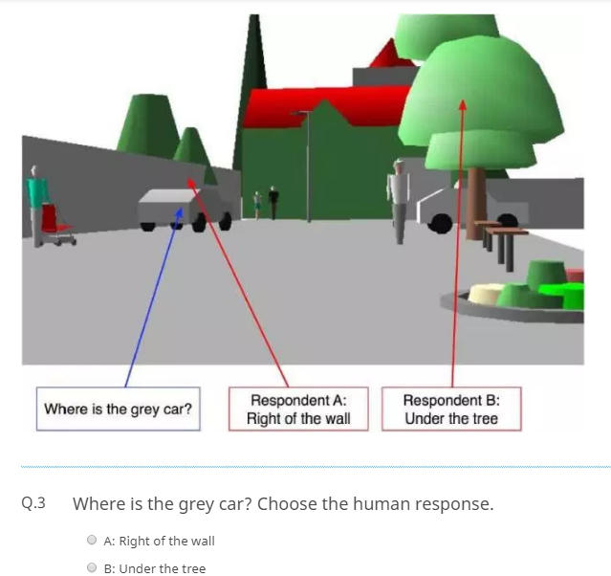

Slide 23
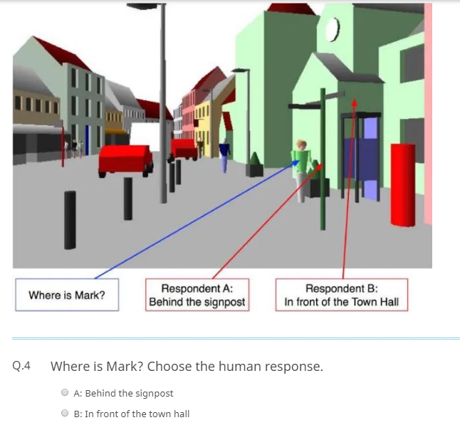

Slide 24
Challenges of NLP
1.Ambiguity in Language:
1. Semantic Ambiguity: Phrases or sentences may have different meanings depending on the context.
Example: "The chicken is ready to eat" (Does it refer to food or the animal?).
2. Syntactic Ambiguity: Sentences can be structured in ways that lead to multiple interpretations.
Example:
"The man saw the boy with the binoculars."
Did the man use binoculars, or does the boy have binoculars?
NLP Challenge: Parsing the sentence to infer the intended meaning.
3. Lexical Ambiguity: Words have multiple meanings depending on context.
Example:
"The crane is flying over the water."
"Crane" could mean a bird or a construction machine.
NLP Challenge: Determining the correct meaning without explicit context

Slide 25
2.Contextual Understanding
Example:
Conversation: "I went to the store and bought apples. They were delicious."
NLP Challenge: Understanding that "They" refers to "apples.“
Sarcasm: "Oh, great! Another traffic jam!"
NLP Challenge : Recognizing that "great" is sarcastic and implies frustration.
3.Long-Term Dependencies:
In a story: "Sarah cooked dinner. She served pasta. Later, she cleaned the kitchen."
NLP Challenge : Keeping track of references like "She" and actions over multiple sentences.

Slide 26
4.Resource Scarcity for Low-Resource Languages
Example
Many NLP models are trained on large datasets available for High-resource language: English has vast datasets like Wikipedia, Common Crawl, and news archives.
Languages with fewer resources (e.g., regional African or Indigenous languages) lack digital text data:
Annotated corpora
Pretrained embeddings
Native speakers for data collection
NLP Challenge: Developing models for these languages without sufficient data or pretrained embeddings.

Slide 27
5.Cultural and Regional Differences
English Variants:
American English: "Apartment" vs. British English: "Flat."
"Pants" (US: trousers) vs. "Pants" (UK: undergarments).
Indian English: Words like "prepone" (advance a meeting) or "cousin brother" (male cousin) are not standard in other English dialects.
Arabic Dialects:
Modern Standard Arabic (MSA) is used in formal settings, but spoken dialects (Egyptian Arabic, Levantine Arabic, Gulf Arabic) differ significantly.
Example: The word for "car" is "saiyara" in MSA but could vary in pronunciation and use across regions.
NLP Challenge: Adapting models to handle regional vocabulary and dialect variations.

Slide 28
6.Common-Sense Reasoning
Example:
"Jack dropped the glass on the floor. It broke."
Challenge: Understanding that "It" refers to the glass and not the floor.
"The man couldn't fit his car into the parking space because it was too small."
Ambiguity: Is the "it" referring to the car or the parking space?

Slide 29
7.Domain Adaptation
Source Domain: The domain where the model is initially trained using labeled data.
Example: Movie reviews for sentiment analysis.
Target Domain: The domain where the model needs to be applied, often with limited or no labeled data.
Example: Product reviews for sentiment analysis.
Domain Shift: The difference between the source and target domains, including variations in vocabulary, style, or context.
Goal: Minimize the performance gap when applying a model trained on the source domain to the target domain

Slide 30
Challenges in Domain Adaptation
Vocabulary Mismatch:
Words or terms in the source domain may not appear in the target domain.
Example: "great acting" in movie reviews vs. "easy assembly" in product reviews.
Distribution Differences:
Feature distributions may differ between domains.
Example: The sentiment polarity of "cheap" might be positive for products (affordable) but negative for services (poor quality).
Limited Data in Target Domain:
The target domain often lacks labeled data, making direct supervised learning impractical.

Slide 31
Language Modelling
A Language Modelling (LM) is a statistical tool in Natural Language Processing (NLP) that predicts the next word or sequence of words based on the context of previously seen words. It enables machines to understand and generate human-like text.
Language models estimate the probability of a sequence of words:
P(W)=P(w1,w2,w3,…,wn)
For example:
Input: "The cat is on the"
Output: Most likely continuation: "mat" (high probability) vs "sky" (low probability).

Slide 32
Types of Language Models
Language models can be categorized into Traditional Statistical Models and Modern Neural Models.
Statistical Language Models (SLMs): These models rely on probabilities derived from word occurrences in large datasets.
Example: n-gram models
Neural Language Models (NLMs): These use neural networks to learn word relationships and contexts.
Example: Word2Vec (vector representation of words) or GloVe They map words to vectors, capturing semantic relationships.

Slide 33
Statistical Language Models(SLMs)
N-Gram Model
An n-gram model is a statistical language model used to predict the next word in a sequence based on the previous n−1 words.
It simplifies language modeling by assuming that the probability of a word depends only on the last n−1 words, making it computationally efficient but limited in capturing long-range dependencies.
Unigram: Considers only single words (n-1).
Bigram: Considers pairs of consecutive words (n-2).
Trigram: Considers triplets of words (n-3).
4-gram, 5-gram, etc.: Extend to more context.
Notes:
Unigram (n = 1)
Looks at one word at a time.
No context is used.
Example: Sentence → “We love programming” Unigrams → “We”, “love”, “programming”
Used for simple probability calculations.
2️⃣ Bigram (n = 2)
Looks at two consecutive words.
Predicts the next word using the previous 1 word.
Example: “We love”, “love programming”
3️⃣ Trigram (n = 3)
Looks at three consecutive words.
Predicts next word based on previous 2 words.
Example: “We love programming” → predicts next word from “love programming”
4-Gram, 5-Gram, …
Looks at longer context.
More accurate but requires more data.

Slide 34
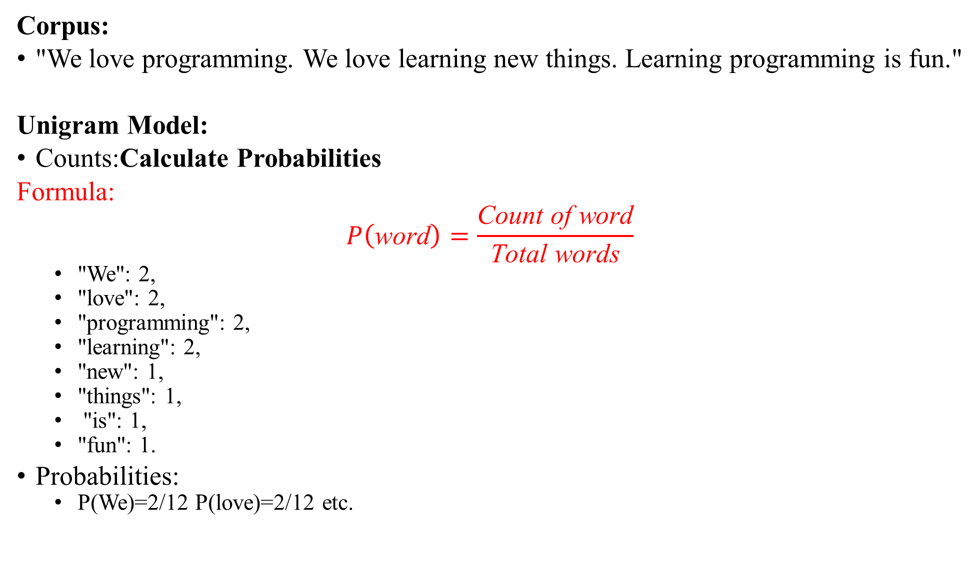
Corpus:
"We love programming. We love learning new things. Learning programming is fun."
Unigram Model:
Counts:Calculate Probabilities
Formula:
$$P\left(\text{word}\right)=\frac{\text{Count} \text{of} \text{word}}{\text{Total} \text{words}}$$
"We": 2,
"love": 2,
"programming": 2,
"learning": 2,
"new": 1,
"things": 1,
"is": 1,
"fun": 1.
Probabilities:
P(We)=2/12 P(love)=2/12 etc.
Notes:
Corpus = A big dataset of text. It contains sentences, paragraphs, documents, or spoken transcripts.

Slide 35
Bigram Model:
Counts:
("We", "love"): 2,
("love", "programming"): 1,
("love", "learning"): 1,
("learning", "new"): 1, etc.
Probabilities:
P(love∣We)=Count(We, love)/Count(We)=2/2=1
P(programming∣love)=Count(love, programming)/Count(love)=1/2=0.5

Slide 36
What is a Token?
A token is one small unit of text.
In NLP, a token is usually:
a word
or a special symbol
Example sentence:
We love programming
Tokens:
["we", "love", "programming"]
Each word becomes one token This process is called tokenization
What is Corpus ?
A corpus is a large collection of text or sentences used for language analysis or training a model in NLP.

Slide 37
Corpus:
"We love programming. We love learning new things. Learning programming is fun."
Step 1: Prepare the Data
Break the corpus into sentences, lowercase the text, and tokenize it (split into words):
Tokens: ["we", "love", "programming", "we", "love", "learning", "new", "things", "learning", "programming", "is", "fun"]
Add a special <START> token to indicate the beginning of a sentence and <END> for the end:
Tokens:
["<START>", "we", "love", "programming", "<END>",
"<START>", "we", "love", "learning", "new", "things", "<END>",
"<START>", "learning", "programming", "is", "fun", "<END>"]

Slide 38
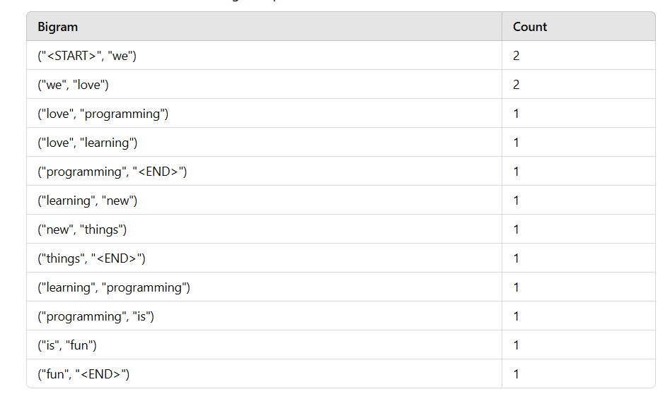
Step 2: Build Bigram Model List all bigrams
Now, take two words at a time:

Slide 39
Step 2.1:Count each bigram
Now count how many times each bigram appears.
What does this mean?
It tells us which word usually follows another word
Example:
After "we" → "love" occurs 2 times
After "learning" → "new" and "programming" both occur(possibilities of one or other word)
This information is used to predict the next word.

Slide 40
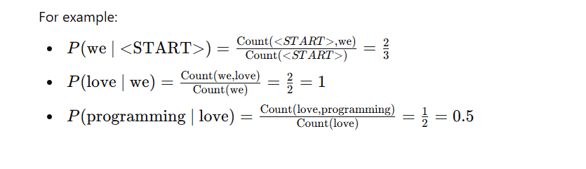
Step 3: Calculate Probabilities In Step 2, we counted how many times word pairs (bigrams) occur. In Step 3, we convert those counts into probabilities.
This tells us: If we see word w1, how likely is word w2 to come next?
For each word pair (w1,w2),
calculate the conditional probability:
P(w2∣w1)=Count(w1,w2)/Count(w1)
Count(w1, w2) → How many times w2 comes after w1
Count(w1) → How many times w1 appears as a first word in any bigram
P(w2 | w1) → Probability that w2 comes next, given w1

Slide 41
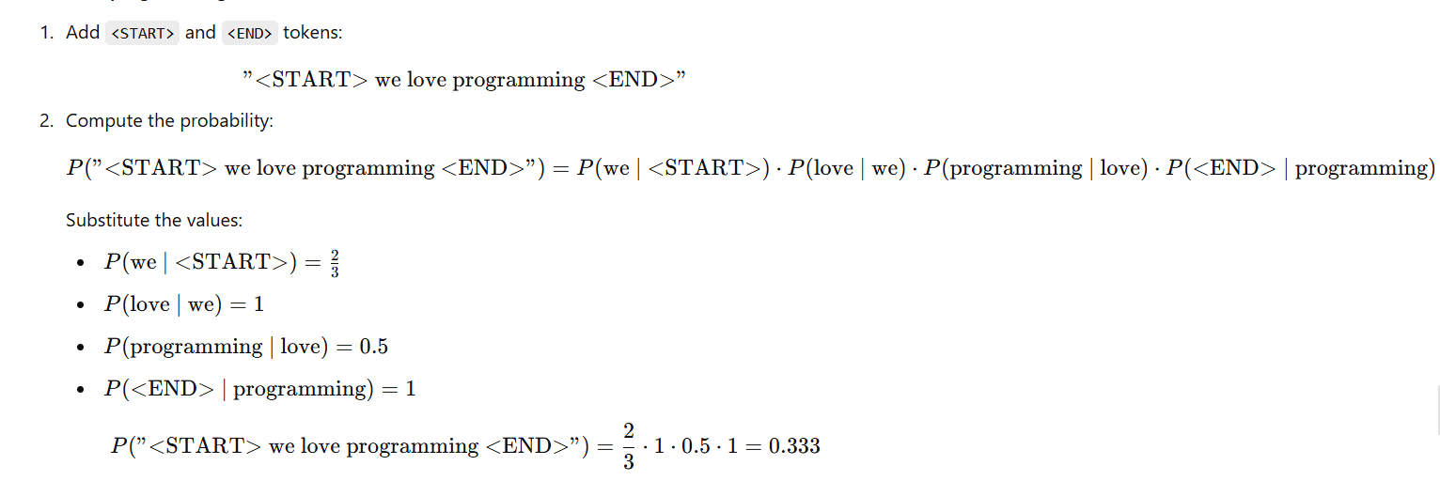
Step 4: Predict the Sentence
Let’s calculate the probability of the sentence:
"We love programming".

Slide 42
Step 5: Interpretation
The probability of the sentence "We love programming" is 0.333. This score indicates how likely the sentence is based on the training data.
Higher probability sentences are considered more "natural" in the language modeled by the corpus.

Slide 43
Neural Language Models include Feedforward Neural Networks, Recurrent Neural Networks (RNNs), Long Short-Term Memory Networks (LSTMs), and Transformers.
Neural models learn embeddings (numerical representations of words) to capture semantic relationships.
RNNs process sequences but struggle with long-term dependencies, which LSTMs overcome.
Transformers, such as BERT and GPT, use attention mechanisms for better context understanding.
For example, GPT can generate coherent paragraphs of text, while BERT excels in tasks like sentiment analysis.

Slide 44
What is BERT?
BERT stands for Bidirectional Encoder Representations from Transformers.
BERT is a pre-trained language model used in Natural Language Processing (NLP) to understand text like humans do.
Why BERT is special
Bidirectional understanding
Earlier models read text only left → right.
BERT reads:
Left to right
Right to left
Both sides at the same time
Example:
“I went to the bank to deposit money”
BERT understands that “bank” means financial bank, not river bank, because it looks at surrounding words.

Slide 45
Regular Expressions:
Regular Expressions are used to generate patterns of strings.
Regular Expressions are used widely for replace/search.
Regular Expression is a text string that describes some set of strings.

Slide 46
Definition of a Regular Expression
• R is a regular expression if it is:
1. a for some a in the alphabet , standing for the language {a}
2. ε, standing for the language {}
3. Ø, standing for the empty language
4. R1+R2 where R1 and R2 are regular expressions, and + signifies union (sometimes | is used)
5. R1R2 where R1 and R2 are regular expressions and this signifies concatenation
6. R* where R is a regular expression and signifies closure
7. (R) where R is a regular expression, then a parenthesized R is also a regular expression

Slide 47
Regular Expression in NLP
In Natural Language Processing (NLP), regular expressions (regex) are widely used for text preprocessing, pattern matching, and extracting structured data from unstructured text. Here are common examples and use cases for regular expressions in NLP:
1. Tokenization (Splitting Text into Words)
Regex:
\w+
\w: Matches any word character, which includes letters, digits, and underscores.
+: Matches one or more of the preceding token (\w).
This regex helps break a string into "tokens" (basic units of text like words) by identifying continuous sequences of word characters.
Input: "NLP is amazing!"
Tokens Matched: ['NLP', 'is', 'amazing']
Notes:
It is a powerful tool using special character sequences to define search patterns for matching finding replacing or validating text.

Slide 48
Break it into parts:
1. \w
\w means word character It matches:
Letters: a–z, A–Z
Digits: 0–9
Underscore: _
2. +
+ means one or more times
So,\w+ means one or more word characters together

Slide 49
1.Removing Punctuation
Regex:
[^\w\s]
^: Inside square brackets, it means "not."
\w: Matches word characters (letters, digits, underscores).
\s: Matches whitespace (spaces, tabs, newlines).
[^\w\s]: Matches anything that’s not a word character or whitespace, i.e., punctuation or special symbols.
Use in NLP:
Cleans text by removing unnecessary punctuation, making it easier to process or analyze.
Input: "Hello, world! How's it going?“
Output "Hello world Hows it going"

Slide 50
2.Extracting Hashtags
Regex:
Use in NLP:
Social media text often contains hashtags. Extracting them can help in trend analysis or topic modeling.
Input: "Love #NLP and #MachineLearning!"
Hashtags Extracted: ['#NLP', '#MachineLearning’]
How NLP extracts hashtags (conceptual idea)
NLP systems:
1.Scan the text
2.Look for words that start with #
3.Continue collecting characters until a space or symbol appears
#\w+
#: Matches the literal # character.
\w+: Matches one or more word characters

Slide 51
3.Extracting Numbers
Regex:d+(\.\d+)?
Without backslash:d is a letter
With Backslash d match any digit (0–9)
Use in NLP:
Useful for extracting numerical data from text, such as prices, ages, or statistics.
Example:
Input: "The price is 49.99 dollars."
Numbers Extracted: ['49.99']
\d+: Matches one or more digits.
(\.\d+)?: Optionally matches a decimal point followed by one or more digits.
Together, it matches integers and floating-point numbers.
\d → matches any digit (0–9)
+ → one or more digits
(\.\d+)? → optional decimal part
\. → decimal point
\d+ → digits after decimal
? → makes the decimal part optional

Slide 52
4.Detecting Email Addresses
Regex:
[a-zA-Z0-9._%+-]+@[a-zA-Z0-9.-]+\.[a-zA-Z]{2,}
[a-zA-Z0-9._%+-]+: Matches the local part of the email address (before @).
@: Matches the literal @ symbol.
[a-zA-Z0-9.-]+: Matches the domain name.
\.[a-zA-Z]{2,}: Matches the top-level domain, such as .com, .org.
Use in NLP:
Extracting emails from documents or communications for customer data processing or analysis.
Input: "Contact us at info@example.com or support@domain.org."
Emails Extracted: ['info@example.com', 'support@domain.org']

Slide 53
Foundations of Formal Languages
Language
Grammar
Notations
1.Terminal
2.Non terminal

Slide 54
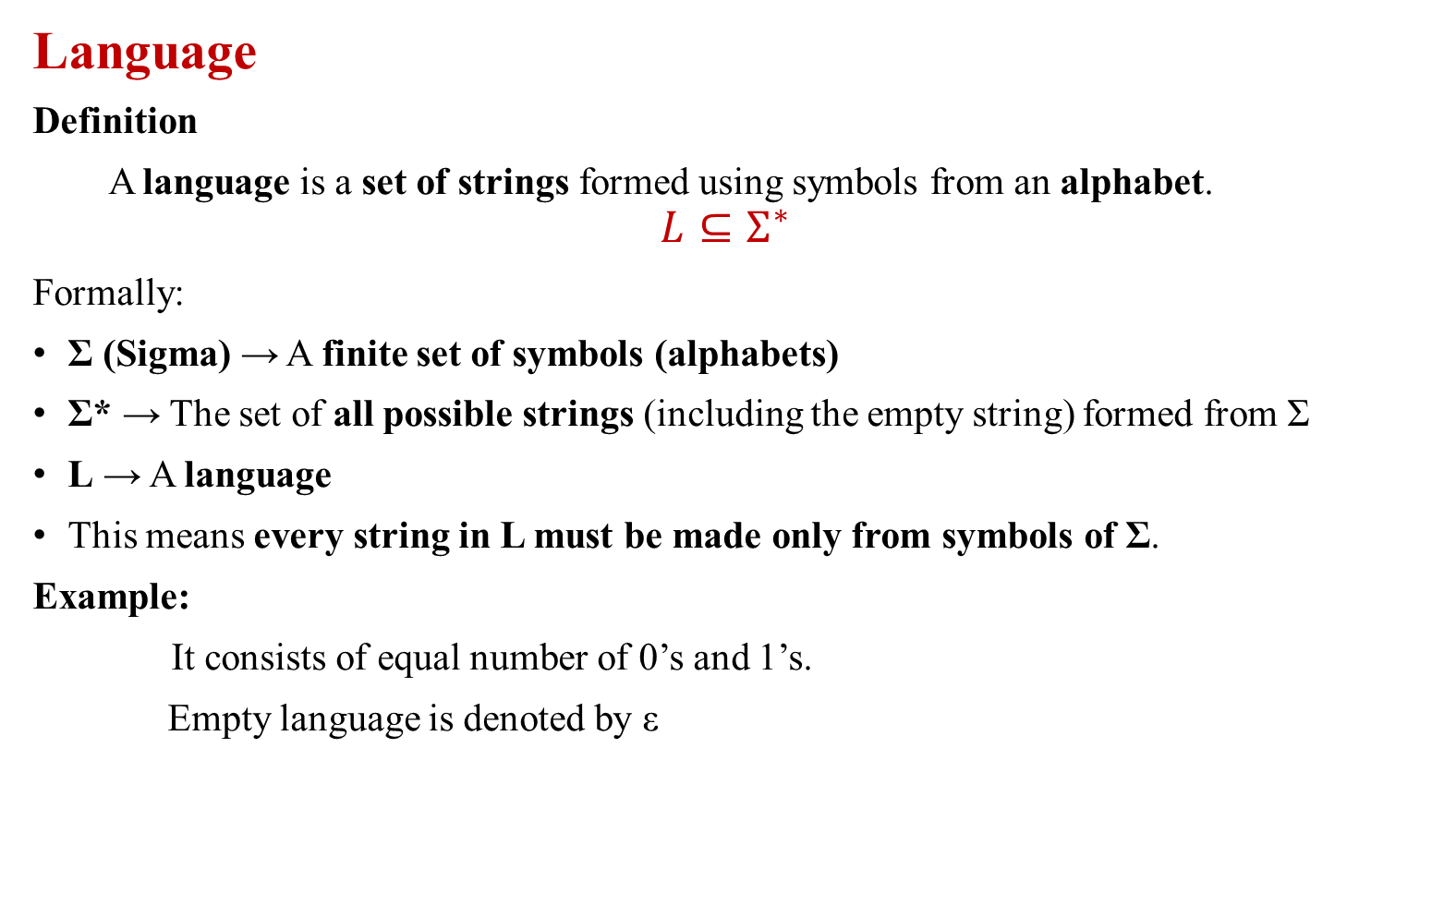
Language
Definition
A language is a set of strings formed using symbols from an alphabet.
$$L⊆Σ^{∗}$$
Formally:
Σ (Sigma) → A finite set of symbols (alphabets)
Σ* → The set of all possible strings (including the empty string) formed from Σ
L → A language
This means every string in L must be made only from symbols of Σ.
Example:
It consists of equal number of 0’s and 1’s.
Empty language is denoted by ε

Slide 55
Grammar
Definition
Mathematical model used to design a software
To identify the syntax of a language.
To identify the syntax of statement
Grammar(G) is 4 tuple or quadruple consist of the following.
Grammar G=(V,T,P,S) where
V is a set of non terminals
T is a set of terminals
P is a set of rules called productions
S is a start symbol.

Slide 56
Notations
Terminals:
Lowercase letters
Operator symbols such as +,-,*..etc.,
Special Characters
Digits
Non-Terminals:
Uppercase letter
Letter S when it appears usually the start symbol.

Slide 57
Example:
Consider the grammar shown below from which any arithmetic expression can be obtained.
E E + E
E E - E
E E * E
E E / E
E id
Generate the string id+id*id. And show the derivation.

Slide 58
E E + E
id+E (By applying E id)
id+E*E (By applying E E*E)
id+id*E(By applying E id)
id+id*id(By applying E id)

Slide 59
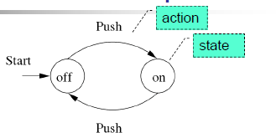
Finite Automata :
Finite Automata is a machine with a finite number of states that processes an input string and accepts it if it ends in a final state.
Examples:
On/Off switch state
Transition Diagram
Circle is used to denote States
Arrow is used transition
Starting state is denoted by using an arrow labelled start
Final State are denoted by double circle.

Slide 60
DETERMINISTIC FINITE AUTOMATA
A Deterministic Finite Automaton (DFA) is a type of finite automaton in which for every state and every input symbol, there is exactly one possible next state.
A DFA is 5 tuple: M= (Q, Ʃ, δ, q0, F)
• A finite set of states Q.
• A finite set of input symbols (letters) Ʃ .
• A Transition function is δ which is mapping from Q x Ʃ to Q.Based on the current state and input symbol, the machine may enter in to another state.
A starting state, q0, which is one of the states of Q.
A set F ⊆ Q of final/accepting states.

Slide 61
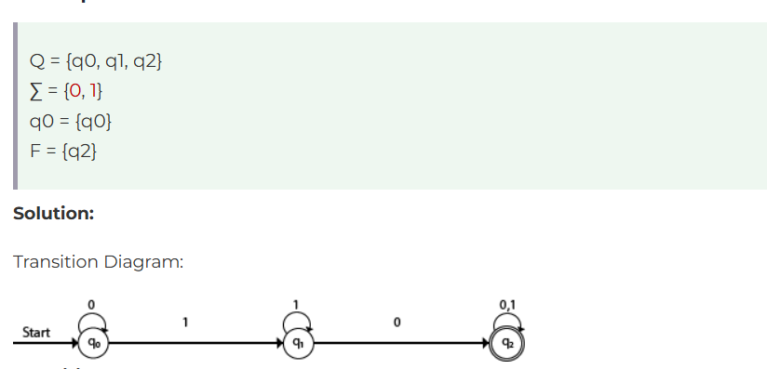

Slide 62
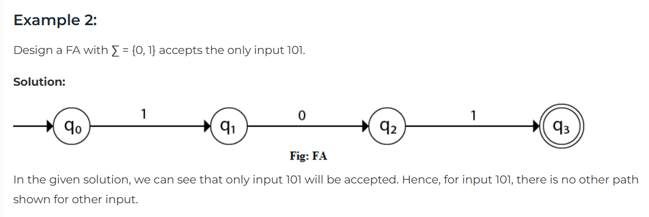

Slide 63
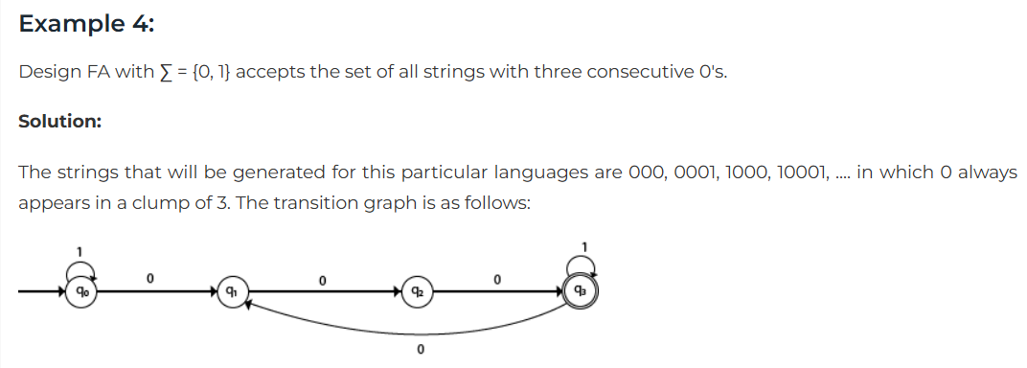

Slide 64
NDFA
Multiple Start State.
More than one transition for each input symbol
Similar to DFA
Support ε transition.
We cannot determine exactly in which state the machine will be.
NON DETERMINISTIC FINITE AUTOMATA
A DFA is 5 tuple: M= (Q, Ʃ, δ, q0, F)
A finite set of states Q.
• A finite set of input symbols (letters) Ʃ .
• A Transition function is δ which is mapping from Q x Ʃ to subsets of 2^{Q} .
A starting state, q0, which is one of the states of Q.
A set F ⊆ Q of final accepting states.

Slide 65
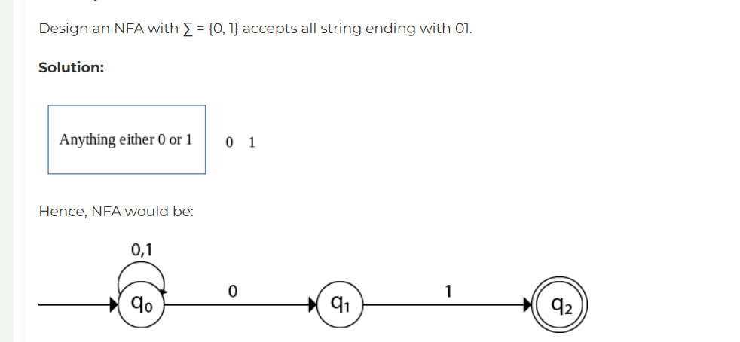

Slide 66
Morphology in NLP
Morphology is the study of the structure and formation of words. It deals with:
Inflection: Changing the form of a word to express grammatical features (e.g., tense, number).
Derivation: Creating new words by adding prefixes or suffixes (e.g., happy → happiness).
Compounding: Combining words to form a new word (e.g., sunflower).
Finite Automata in Morphology
Finite Automata (FA) is a computational model used to recognize patterns in strings. In morphology, FA can process and identify word formations based on rules of a language.

Slide 67
Finite State Automata (FSA) in English Morphology
An FSA is used to recognize patterns in strings, such as identifying valid word forms in a language.
It works by:
States: Representing stages of recognition.
Transitions: Defining the rules for moving from one state to another based on input.
In English morphology, FSAs can model:
Word Formation: Valid sequences of letters forming a word.
Inflections: Patterns for pluralization, verb conjugation, etc.

Slide 68
Types of Finite Automata
1. Deterministic Finite Automata (DFA):
Each state has exactly one transition for a given input.
Suitable for straightforward recognition tasks.
2. Non-Deterministic Finite Automata (NFA):
A state can have multiple transitions for a single input.
Easier to construct but computationally equivalent to DFA.

Slide 69
Steps to Use Finite Automata in Morphology
Step 1: Define the Alphabet
The alphabet is the set of characters that make up the words. For example:
Alphabet = {a, b, c, ..., z}
Step 2: Define Morphological Rules
Identify the rules for affixation, roots, and grammatical forms. For instance:
Adding -ed for past tense.
Adding -ing for the present participle.
Step 3: Design the Finite Automaton
Create states representing different morphological stages.
Define transitions based on input characters.
Step 4: Input Words
Provide the finite automaton with input words to process.
Step 5: Accept or Reject
Check if the input word is accepted based on the defined rules and transitions.

Slide 70
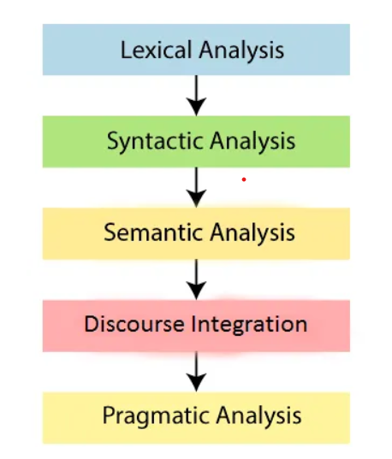
Phases of NLP:

Slide 71
Phases of NLP
1.Lexical Analysis (Tokenization)
Definition: This is the process of breaking down a given text into smaller units such as words, sentences, or phrases. This step helps identify the individual elements in the text.
Key Tasks:
Word Tokenization: Splitting text into words.
Sentence Tokenization: Splitting text into sentences.
Example:
Input: "Natural Language Processing is amazing! It is fun to learn."
Word Tokens: ['Natural', 'Language', 'Processing', 'is', 'amazing', '!', 'It', 'is', 'fun', 'to', 'learn', '.']
Sentence Tokens: ["Natural Language Processing is amazing!", "It is fun to learn."]
Applications:
Preparing text for analysis.
Input for machine learning models in NLP tasks.

Slide 72
2.Morphological Analysis
Definition: This step focuses on analyzing the structure of words to identify their base forms (roots), prefixes, suffixes, and grammatical properties.
Key Tasks:
Stemming: Reducing a word to its base form by removing affixes.
Example: "running", "runner" → "run".
Lemmatization: Converting a word to its dictionary (canonical) form, considering grammar.
Example: "better" → "good", "running" → "run".
Example:
Input: "The cars are running fast."
Stemmed Output: ['The', 'car', 'are', 'run', 'fast']
Lemmatized Output: ['The', 'car', 'be', 'run', 'fast’]
Applications:
Information retrieval systems (search engines).
Text normalization in preprocessing.

Slide 73
3.Syntactic Analysis (Parsing)
Definition: This phase involves analyzing the grammatical structure of a sentence to ensure it follows the rules of a given language. It generates a parse tree or syntax tree to represent relationships between words.
Key Tasks:
Analyzing phrases, clauses, and their hierarchy.
Identifying subject, verb, object, etc.

Slide 74
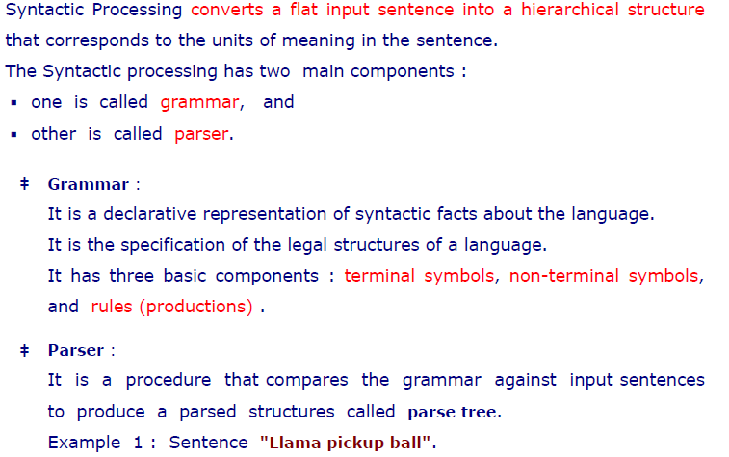
Syntactic Processing/Analysing

Slide 75
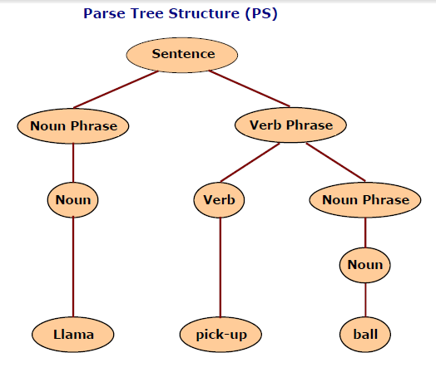

Slide 76
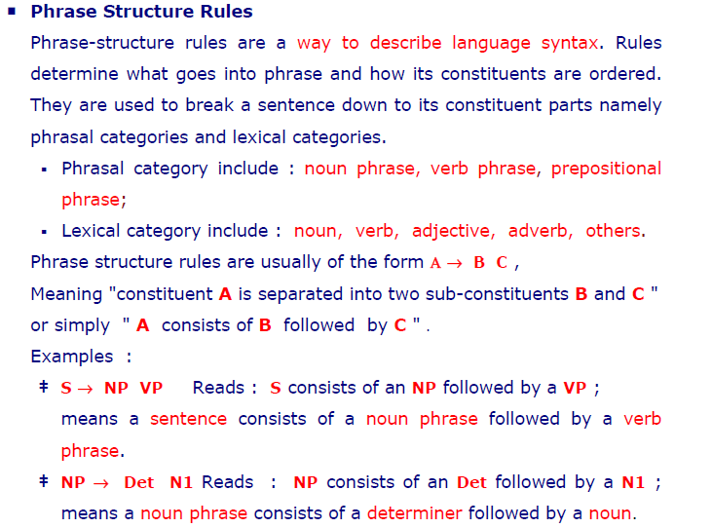

Slide 77
Grammar:
A set of rules defining how words and phrases combine to form valid sentences.
Example: A simple CFG
S → NP VP (A sentence consists of a noun phrase and a verb phrase)
NP → Det N (A noun phrase consists of a determiner and a noun)
VP → V NP (A verb phrase consists of a verb and a noun phrase)
Det → 'the' (Determiner can be 'the')
N → 'dog' | 'cat' (Nouns can be 'dog' or 'cat')
V → 'chased' | 'saw' (Verbs can be 'chased' or 'saw')

Slide 78
Example Sentence:
"The dog chased the cat."
Grammar Rules:
S → NP VP
NP → Det N
VP → V NP
Det → 'the'
N → 'dog' | 'cat'
V → 'chased'

Slide 79
Parse Tree: The sentence "The dog chased the cat" can be parsed into the following tree:
S
/ \
NP VP
/ \ / \
Det N V NP
| | | / \
the dog chased Det N
| |
the cat

Slide 80
Example 1: "The cat saw the dog.“
Grammar Rules
S → NP VP
NP → Det N
VP → V NP
Det → 'the'
N → 'cat' | 'dog'
V → 'saw'
Parse Tree
S
/ \
NP VP
/ \ / \
Det N V NP
| | | / \
the cat saw Det N
| |
the dog

Slide 81
Example 2: "The dog barked."
Grammar Rules:
S → NP VP
NP → Det N
VP → V
Det → 'the'
N → 'dog'
V → 'barked'
S
/ \
NP VP
/ \ |
Det N V
| | |
the dog barked

Slide 82
Example "A boy plays."
Grammar Rules:
S → NP VP
NP → Det N
VP → V
Det → 'a'
N → 'boy'
V → 'plays'
S
/ \
NP VP
/ \ |
Det N V
| | |
a boy plays

Slide 83
Example : "She reads books."
Grammar Rules:
S → NP VP
NP → Pronoun
VP → V NP
Pronoun → 'she'
V → 'reads'
NP → N
N → 'books'
S
/ \
NP VP
| / \
Pronoun V NP
| | |
she reads books

Slide 84
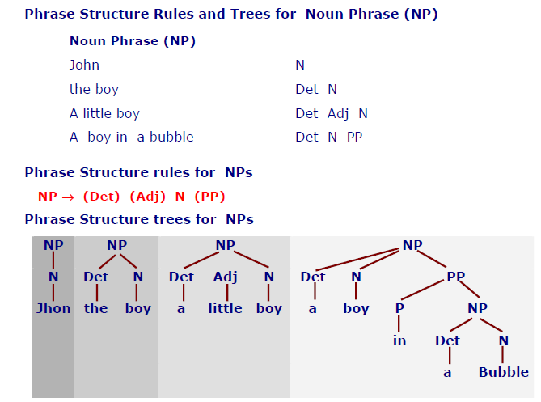

Slide 85
Semantic Analysis
Semantic Analysis is a phase in NLP that focuses on understanding the meaning of text. It goes beyond syntax (structure) to interpret the actual meaning of words, phrases, and sentences. The goal is to ensure that the text makes sense and to extract meaningful information.
Key Tasks in Semantic Analysis:
Word Sense Disambiguation:
Determine the correct meaning of a word based on context.
Example: The word "bank" can mean a financial institution or the side of a river.
Entity Recognition:
Identify and classify entities like people, places, dates, etc.
Relationship Extraction:
Understand relationships between entities.
Example: "John works at Google" → John (Person) works at (Relationship) Google (Organization).
Semantic Role Labeling:
Identify the roles of words in a sentence (e.g., who did what to whom).
Example: In "John ate an apple," John is the doer (agent), and the apple is the object.

Slide 86
Example of Semantic Analysis
Sentence:
"The cat chased the mouse."
Step 1: Syntactic Analysis (Parsing)
The sentence is parsed into its syntactic structure:
Subject: "The cat"
Verb: "chased"
Object: "the mouse"

Slide 87
Step 2: Semantic Analysis
Word Sense Disambiguation:
"Cat" refers to the animal, not the acronym or slang.
"Mouse" refers to the small rodent, not the computer device.
Entity Recognition:
"The cat" → Entity: Animal
"The mouse" → Entity: Animal
Relationship Extraction:
The cat (Agent) chased (Action) the mouse (Object).
Semantic Role Labeling:
Agent: "The cat" (doer of the action)
Action: "chased" (the verb)
Object: "the mouse" (receiver of the action)

Slide 88
Semantic Representation:
The semantic analysis produces a structured representation of the sentence's meaning:
Agent: The cat
Action: chased
Object: the mouse
Another Example with Ambiguity
Sentence:
"She went to the bank."
Step 1: Syntactic Analysis (Parsing)
Subject: "She"
Verb: "went"
Prepositional Phrase: "to the bank"

Slide 89
Step 2: Semantic Analysis
Word Sense Disambiguation:
"Bank" could mean:
A financial institution (e.g., "She deposited money at the bank").
The side of a river (e.g., "She sat by the bank of the river").
Contextual Clues:
If the previous sentence was "She needed to withdraw money," the meaning of "bank" is likely the financial institution.
If the previous sentence was "She enjoyed the view of the river," the meaning of "bank" is likely the side of the river.
Entity Recognition:
"She" → Entity: Person
"The bank" → Entity: Location (financial institution or riverbank)
Relationship Extraction:
She (Agent) went (Action) to the bank (Location).

Slide 90
Semantic Representation:
Agent: She
Action: went
Location: the bank (financial institution or riverbank, depending on context)

Slide 91
Discourse Integration is a process in Natural Language Processing (NLP) that focuses on understanding how sentences or utterances are connected to form a coherent text or conversation. It involves analyzing the relationships between sentences, identifying the overall structure of the discourse, and resolving references (like pronouns or phrases) that depend on context.
In natural language, the meaning of a sentence often depends on the sentences that come before or after it. For example:
Pronouns like "he," "she," or "it" refer to entities mentioned earlier.
The overall topic or theme of a conversation may span multiple sentences.
Sentences may be logically connected (e.g., cause-effect, contrast, or sequence).

Slide 92
Key Tasks in Discourse Integration
Coreference Resolution:
Identifying which words or phrases refer to the same entity.
Example: "John said he is tired." → "he" refers to "John."
Anaphora Resolution:
Resolving references to previously mentioned entities.
Example: "The cat chased the mouse. It was fast." → "It" refers to "the mouse."
Ellipsis Resolution:
Filling in missing information that is implied by context.
Example: "John can play the guitar, and Mary can too." → "Mary can play the guitar."
Discourse Relation Identification:
Understanding how sentences are logically connected.
Example: "It was raining. So, we stayed indoors." → The second sentence explains the consequence of the first.
Topic Continuity:
Tracking the main topic or theme across multiple sentences.

Slide 93
Example of Discourse Integration
Text:
"John went to the store. He bought some apples. They were fresh."
Step 1: Coreference Resolution
Identify that "He" refers to "John."
Identify that "They" refers to "apples."
Step 2: Anaphora Resolution
Resolve "He" to "John."
Resolve "They" to "apples."
Step 3: Discourse Relation Identification
The sentences are connected in a sequence: John went to the store → He bought apples → The apples were fresh.
Step 4: Topic Continuity
The topic is about John's activity (going to the store and buying apples).

Slide 94
Pragmatic Analysis
Definition: This phase interprets the intended meaning of text based on context, speaker intent, and cultural nuances.
Key Tasks:
Understanding implied meanings or indirect requests.
Handling sarcasm, politeness, or idiomatic expressions.
Example:
Input: "Can you open the window?"
Syntactic Meaning: A yes/no question.
Pragmatic Meaning: A polite request to open the window.
Applications:
Sentiment analysis.
Context-aware chatbots.

Slide 95
Let’s consider a chatbot application:
Input: "What's the weather like today?"
Lexical Analysis: Tokenize into ['What', "'s", 'the', 'weather', 'like', 'today', '?'].
Morphological Analysis: Identify base forms: 'What', 'is', 'the', 'weather', 'like', 'today'.
Syntactic Analysis: Check grammar and parse the sentence.
Semantic Analysis: Understand "weather" as a concept and "today" as a time reference.
Discourse Integration: Maintain conversation context, e.g., responding with current weather data.
Pragmatic Analysis: Determine the intent (user wants weather information).
Phonological Analysis: If input is spoken, process the audio and generate spoken output.
Output: "The weather is sunny and 25°C."

Slide 96
Finite State Transducers (FST) in Morphology
While FSAs recognize patterns, FSTs transform input to output, making them ideal for:
Lexicon Encoding: Mapping base forms (lemmas) to surface forms.
Morphological Rules: Applying rules like affixation, vowel harmony, etc.
Key Components of FST
Input Tape: Represents the base form of a word.
Output Tape: Represents the surface form after applying morphological rules.
States: Represent intermediate stages.
Transitions: Map input characters to output characters.

Slide 97
Transducers for Lexicon and Morphological Rules
FSTs handle both the lexicon (word dictionary) and rules (word formation logic).
Step 1: Lexicon Representation
The lexicon includes:
Root words or stems (e.g., "walk").
Affixes for inflection or derivation (e.g., "ed", "ing").
Step 2: Rules Representation
Rules encode transformations:
Add -ed for past tense: "walk" → "walked".
Handle vowel changes for irregular verbs: "run" → "ran".

Slide 98
Step 3: Transducer Construction
State Diagram:
q0​: Start state.
q1​: Intermediate state for root recognition.
q2​: Accept state for valid surface forms.
Transitions:
Input: Root characters.
Output: Surface form characters.

Slide 99
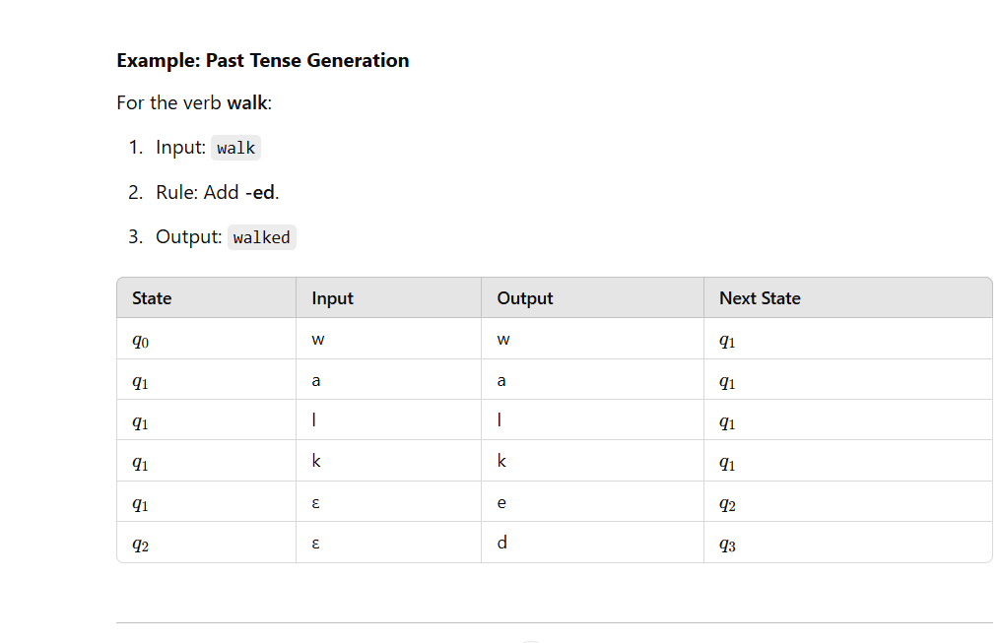

Slide 100
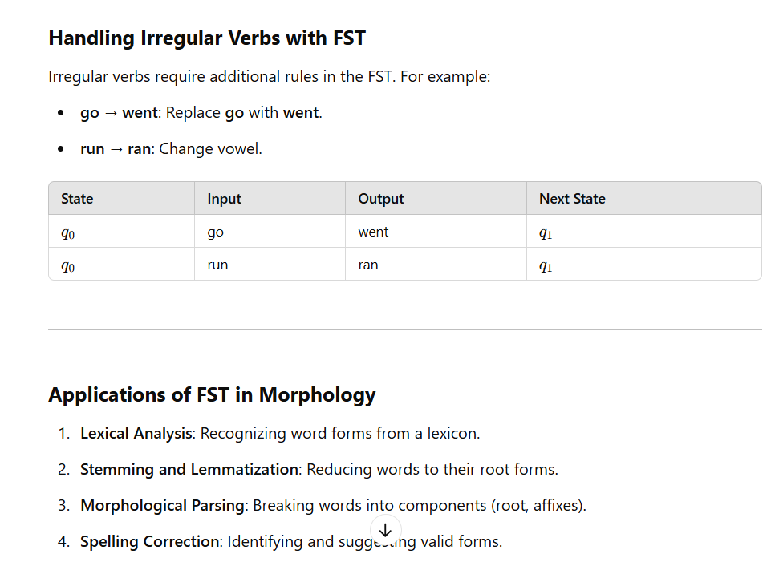

Slide 101
FSA Works in Tokenization
An FSA for tokenization processes a string character by character
and identifies boundaries between tokens.
Example
Input: "I love programming."
Steps:
Define states for recognizing letters, spaces, and punctuation.
Transition between states based on the input.

Slide 102
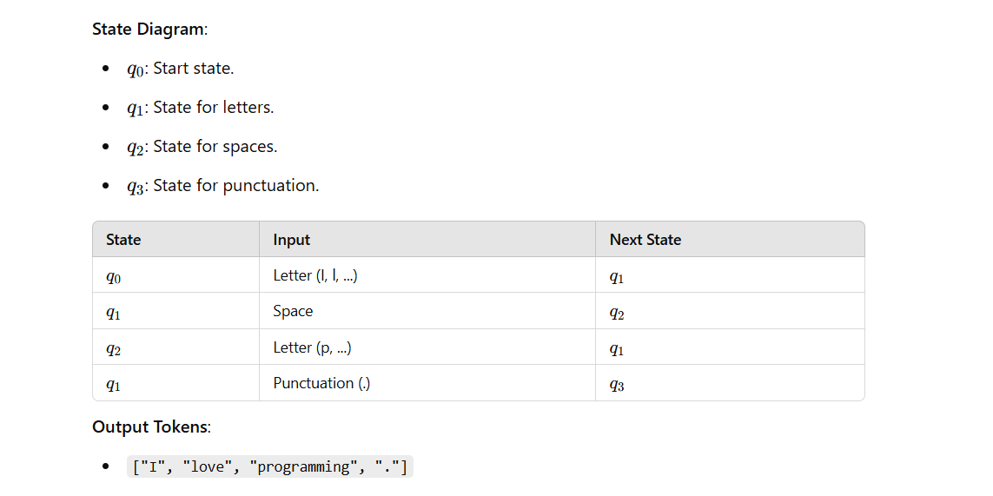

Slide 103
2. Detecting and Correcting Spelling Errors
Detecting Spelling Errors with FSA An FSA can detect spelling errors by:
Using a lexicon of valid words.
Checking if the input word transitions to an accepting state.
Example
Valid words in the lexicon: {"cat", "dog", "rat"}.
Input word: "dat"
Steps:
Start at q0q_0q0​.
Transition based on input letters.
Reject if no valid path exists.

Slide 104
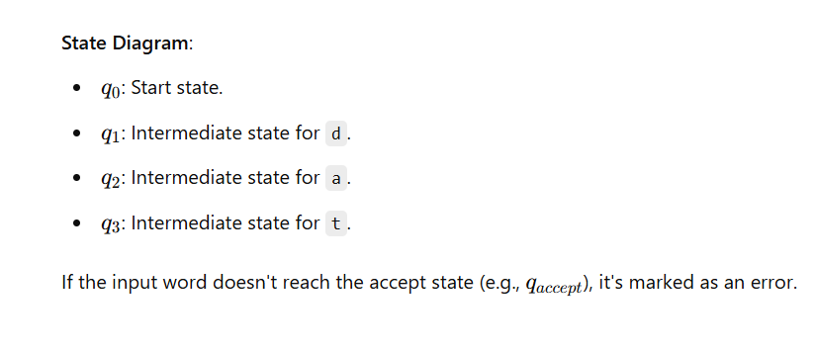

Slide 105
Correcting Spelling Errors with Minimum Edit Distance
Minimum edit distance is the smallest number of operations required to convert one word into another. Operations include:
Insertion: Adding a character.
Deletion: Removing a character.
Substitution: Replacing a character.
Steps to Correct Spelling Errors
Calculate the edit distance between the input word and each valid word in the lexicon.
Choose the word with the smallest edit distance as the correction.

Slide 106
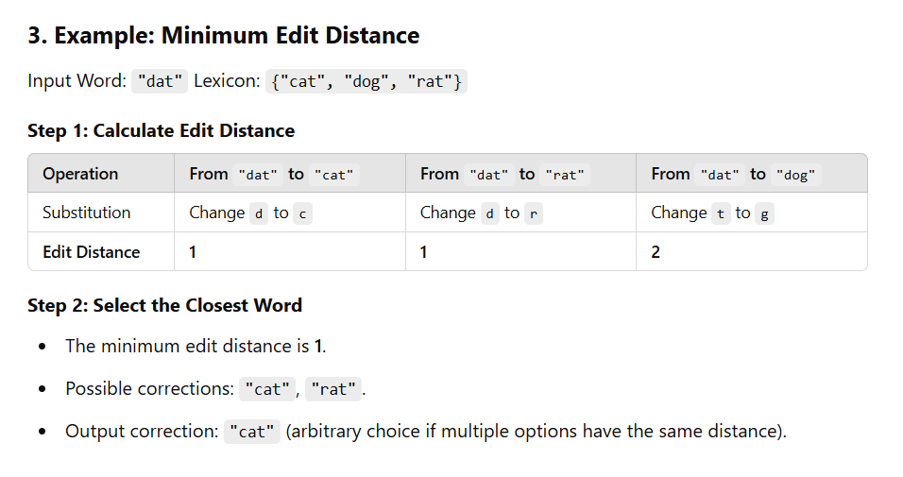

Slide 107
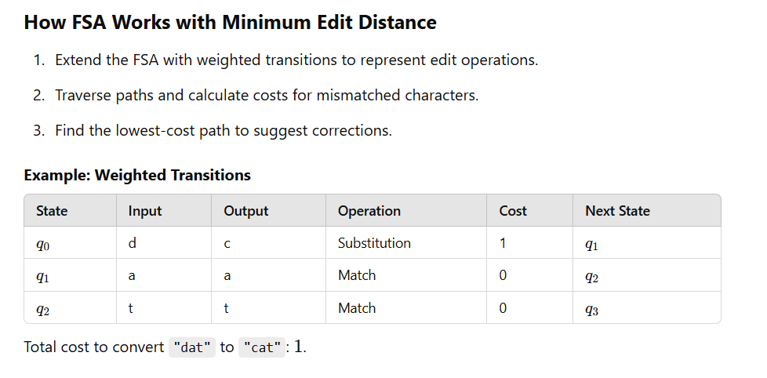

Slide 108
Applications
Tokenization:
Breaking text into words and punctuation.
Preprocessing for machine learning models.
Spelling Correction:
Enhancing user experience in search engines and text editors.
Minimum Edit Distance:
Used in machine translation, speech recognition, and more.

